Slide 1

The concepts of transfer learning
Notes:
‹#›

Slide 2
Objectives
Understanding transfer learning
Coding transfer learning from the inception model
The concepts of transfer learning
‹#›

Slide 3
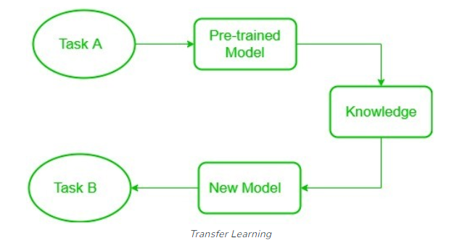
What is Transfer Learning?
Transfer learning is a technique in machine learning where a model trained on one task is used as the starting point for a model on a second task.
Useful when the second task is similar to the first task, or when there is limited data available for the second task.
The concepts of transfer learning
‹#›
Notes:
‹#›

Slide 4
What is Transfer Learning?
Transfer learning is an optimization that allows rapid progress or improved performance when modeling the second task.
Transfer learning is related to problems such as multi-task learning and concept drift and is not exclusively an area of study for deep learning.
The concepts of transfer learning
‹#›
Notes:
‹#›

Slide 5
Why do we need Transfer Learning?
Many deep neural networks trained on images have a curious phenomenon in common: in the early layers of the network, a deep learning model tries to learn a low level of features, like detecting edges, colours, variations of intensities, etc.
Discuss and give your opinions!
The concepts of transfer learning
‹#›
Notes:
‹#›

Slide 6
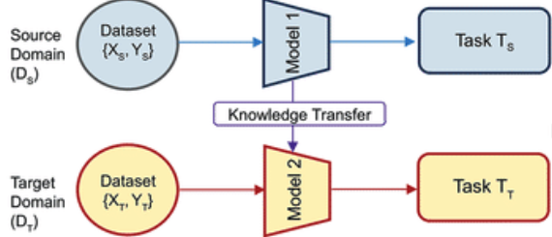
How to use Transfer Learning?
Two common approaches are as follows:
Develop Model Approach
Pre-trained Model Approach
The concepts of transfer learning
‹#›
Notes:
‹#›

Slide 7
How to use Transfer Learning?
Develop Model Approach
1. Select Source Task: select a related predictive modeling problem with an abundance of data where there is some relationship in the input data, output data, and/or concepts learned during the mapping from input to output data.
2. Develop Source Model: develop a skillful model for this first task. The model must be better than a naive model to ensure that some feature learning has been performed.
The concepts of transfer learning
‹#›
Notes:
‹#›

Slide 8
How to use Transfer Learning?
3. Reuse Model: The model fit on the source task can then be used as the starting point for a model on the second task of interest. This may involve using all or parts of the model, depending on the modeling technique used.
4. Tune Model: Optionally, the model may need to be adapted or refined on the input-output pair data available for the task of interest.
The concepts of transfer learning
‹#›
Notes:
‹#›

Slide 9
How to use Transfer Learning?
Pre-trained Model Approach
Select Source Model: A pre-trained source model is chosen from available models. Many research institutions release models on large and challenging datasets that may be included in the pool of candidate models from which to choose from.
Reuse Model: The model pre-trained model can then be used as the starting point for a model on the second task of interest.
Tune Model: Optionally, the model may need to be adapted or refined on the input-output pair data available for the task of interest.
Common in the field of deep learning
The concepts of transfer learning
‹#›
Notes:
‹#›

Slide 10
How does Transfer Learning work?
This is a general summary of how transfer learning works:
Pre-trained Model: Start with a model that has previously been trained for a certain task using a large set of data. Frequently trained on extensive datasets, this model has identified general features and patterns relevant to numerous related jobs.
Base Model: The model that has been pre-trained is known as the base model. It is made up of layers that have utilized the incoming data to learn hierarchical feature representations.
The concepts of transfer learning
‹#›
Notes:
‹#›

Slide 11
How does Transfer Learning work?
Transfer Layers: In the pre-trained model, find a set of layers that capture generic information relevant to the new task as well as the previous one. Because they are prone to learning low-level information, these layers are frequently found near the top of the network.
Fine-tuning: Using the dataset from the new challenge to retrain the chosen layers. We define this procedure as fine-tuning. The goal is to preserve the knowledge from the pre-training while enabling the model to modify its parameters to better suit the demands of the current assignment.
The concepts of transfer learning
‹#›
Notes:
‹#›

Slide 12
Evaluation Transfer Learning
Advantages of transfer learning:
Speed up the training process.
Better performance.
Handling small datasets.
Disadvantages of transfer learning:
Domain mismatch.
Overfitting.
Complexity.
Discuss give your opinions
The concepts of transfer learning
‹#›
Notes:
‹#›

Slide 13
Summary
Understanding ImageDataGenerator
Defining a ConvNet to use complex images
Train the ConvNet with ImageDataGenerator
Exploring the impact of compressing images
The concepts of transfer learning
‹#›

Slide 14
Q & A
The concepts of transfer learning
‹#›

